Slide 1


Semi-Supervised Classification with Graph Convolutional Networks
Junhee Cho
Network Science Lab
The Catholic University of Korea
E-mail : junhe0733@gmail.com

Slide 2
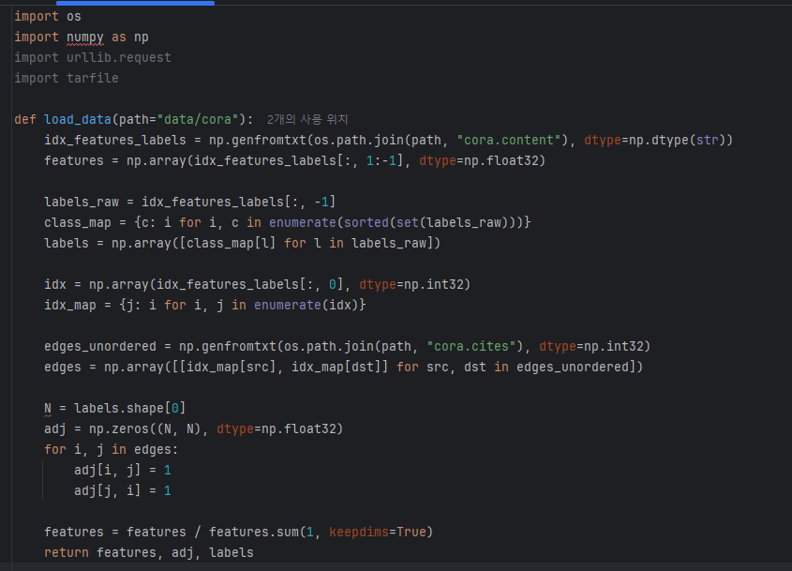
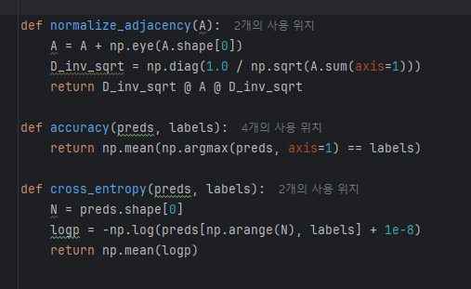
Code
data_loader

Slide 3
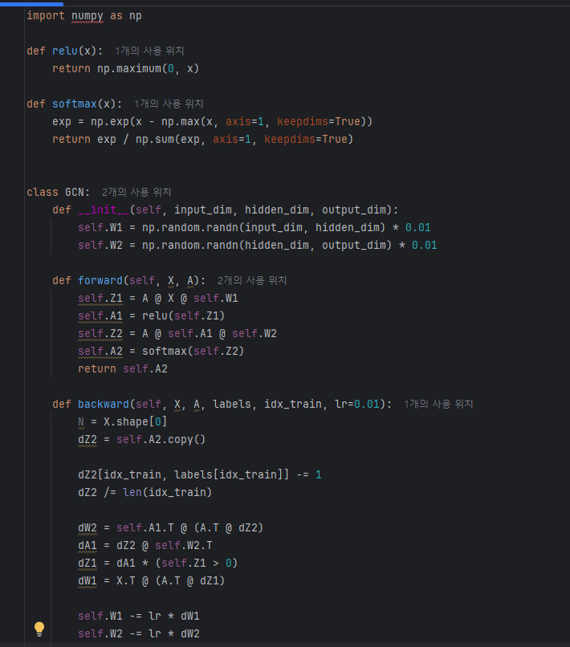
Code
model

Slide 4
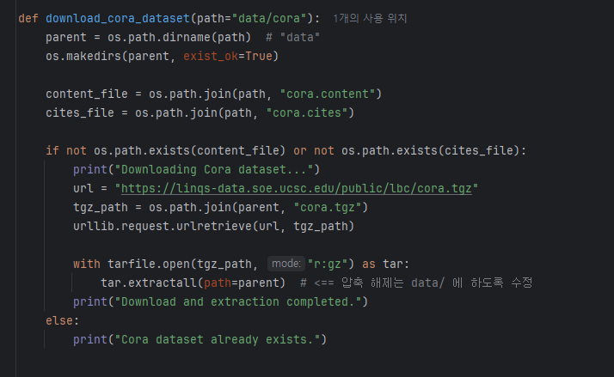
Code
train

Slide 5
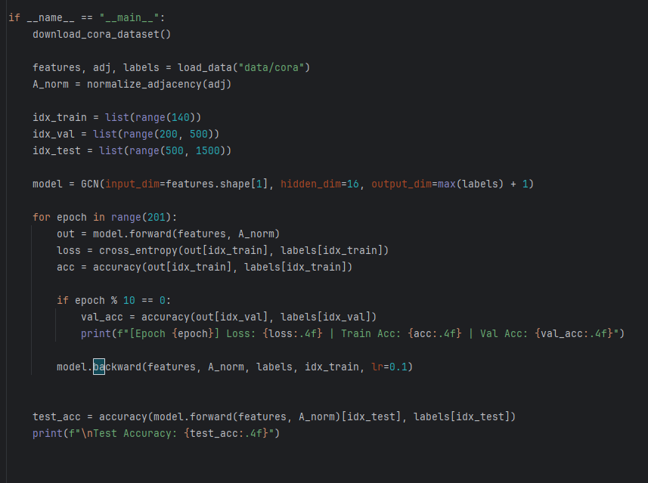
Code
train

Slide 6
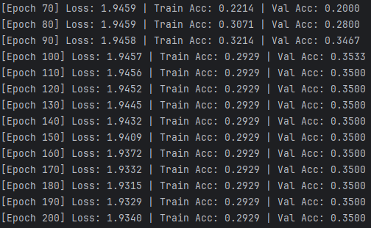
output
Loss

